Slide 1


WP6: AAI and Data transfer status
25th June, 2019
Author: J.Hall, J-F. Perrin (ILL)
This project has received funding from the European Union’s Horizon 2020 research and innovation programme under grant agreement No. 823852

Slide 2
AAI
UmbrellaID: sustainable infrastructure for Joining EOSC
UmbrellaID up to now:
In productions since 2012
1500 users, 15 partners
Core infrastructure: 2 SAML IdPs (PSI & ILL) + Resource registry
Protocols: SAML 2.0, ABFAB (Moonshot)
Partnership with GÉANT (EDUTeams) in order to:
re-inforce the community AAI infrastructure & services
prepare the ground for EOSC Services
Formal vote of the UmbrellaID management comity until 3rd of July 2019.
For WP4 what does it means:

Slide 3
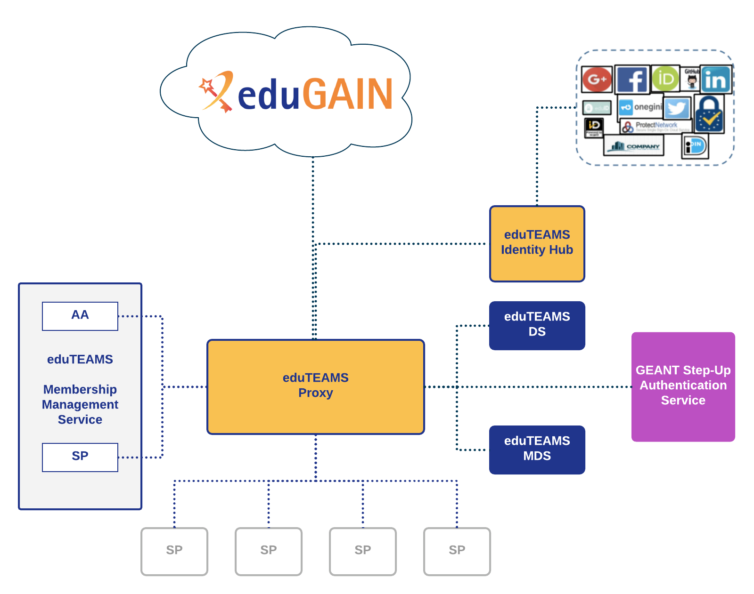
For WP4 in practice:
Implementation of the AARC BPA (Blue Print Architecture)
New protocols available at the SP level (SAML 2.0, Oauth / OIDC, X509)
The eduTEAMS Proxy is responsible for aggregating the user attributes (EAAHash, email, affiliation, …).
A small pilot is available.
In case of positive vote, preparation of the migration in Sep 2019, Rollout end of the year.

Slide 4
Data transfer
3 uses cases
Archiving (cold storage):
Storage provided by STFC (1PB / year)
Initial evaluation: ILL data
Transfer tech candidates: S3, GridFTP, HTTP, FTS3 to control the data transfer
Status: set up ongoing
Data transfer between partner datacentres:
EGI Notebook use case
User access to experimental data when using EGI notebook
Storing the results of the analysis
Transfer tech candidates: ONEDATA, FTS3 to control the data transfer
User data transfer:
Download data locally (including on users’ computer)
Transfer tech candidates: Globus online, ruccio and FTS3 to control the data transfer

Slide 5
WP6 Meetings and notes :
https://github.com/panosc-eu/panosc/tree/master/Work%20Packages/WP6%20EOSC%20Integration
References:
UmbrellaID: https://umbrellaid.org
EDUTeams: https://www.geant.org/Services/Trust_identity_and_security/Pages/eduTEAMS.aspx
ONEDATA: https://onedata.org/
RUCCIO: https://rucio.cern.ch/
FTS3: https://fts.web.cern.ch/

